Slide 1
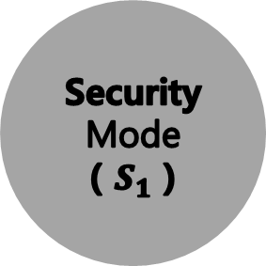
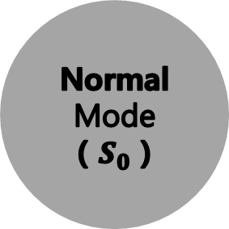
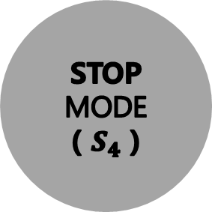
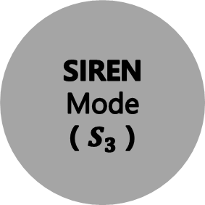
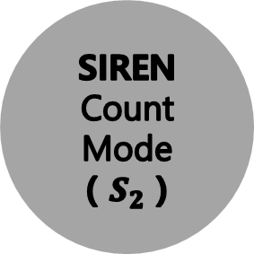
Normal Mode
( $S_{0}$ )
MCU_1 Button
Pressed
Security Mode
( $S_{1}$ )
SIREN TRG
( IndoorLED = 1 )
( WIN_Brake = 1 )
( WIN_OPEN = 1 )
SIREN
Count
Mode
( $S_{2}$ )
MCU_1 Button
Pressed
MCU_1 Button
Pressed
MCU_2
Button Pressed
7-Segment Display = 0
STOP
MODE
( $S_{4}$ )
SIREN
Mode
( $S_{3}$ )
MCU_2
Button Pressed

